Slide 1
Obfuscation Fingerprinting In Android Binaries
Matt Van Veldhuizen

Slide 2
Overview
Summary of Project
What I have Done So Far
Basic Android Application
Obfuscation Programs
Analysis of Obfuscated Application
Looking into the Future
Questions

Slide 3
(De)Obfuscation
Obfuscation
The deliberate act of creating obfuscated code or making source or machine code that is difficult for humans to understand
Deobfuscation
To Convert a program that is difficult to understand into a program that is simple to understand

Slide 4
Summary of Project
Is there a way to determine which obfuscation program was used on the Android Application
Suggest a deobfuscation program to use

Slide 5
What I Have Done So Far
Contacted past researcher
Written own Android App
Ran obfuscators against App
Analysed obfuscated Apps
Started to locate Commercial Apps

Slide 6
What I Have Done So Far
Contact with Yiannis Pavlosoglou
elucidate

Slide 7
Basic Android Application
Wrote Simple App
Consited of Three Parts:
String Encryption
Fibonacci Calculator
Two Different methods
Get Web Page

Slide 8
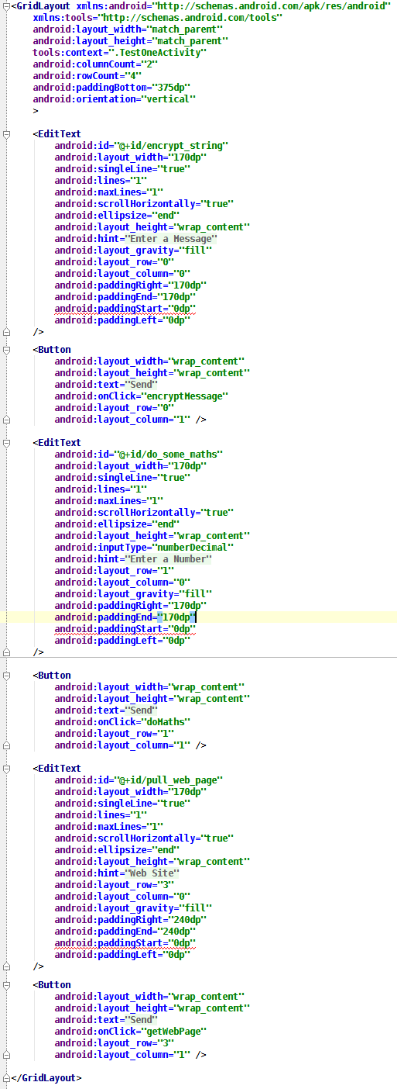
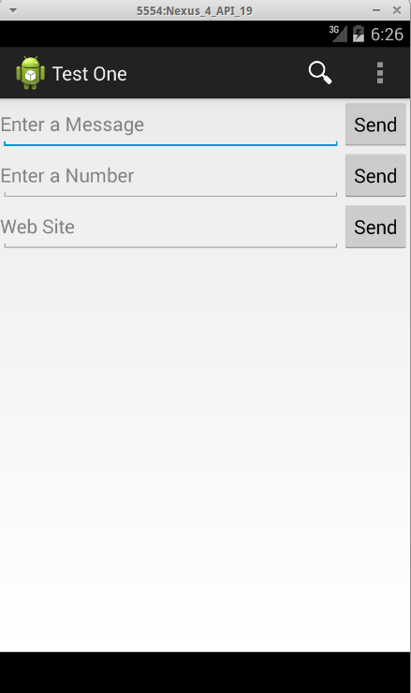
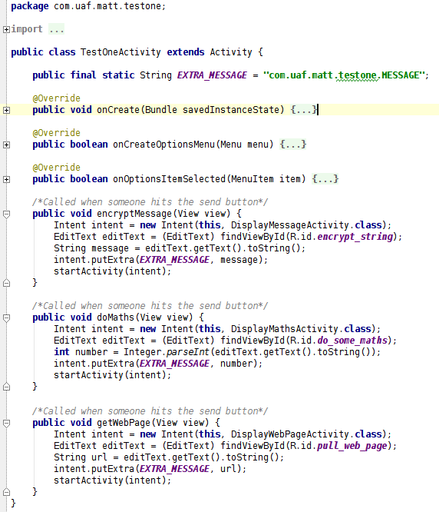
Starting Activity

Slide 9
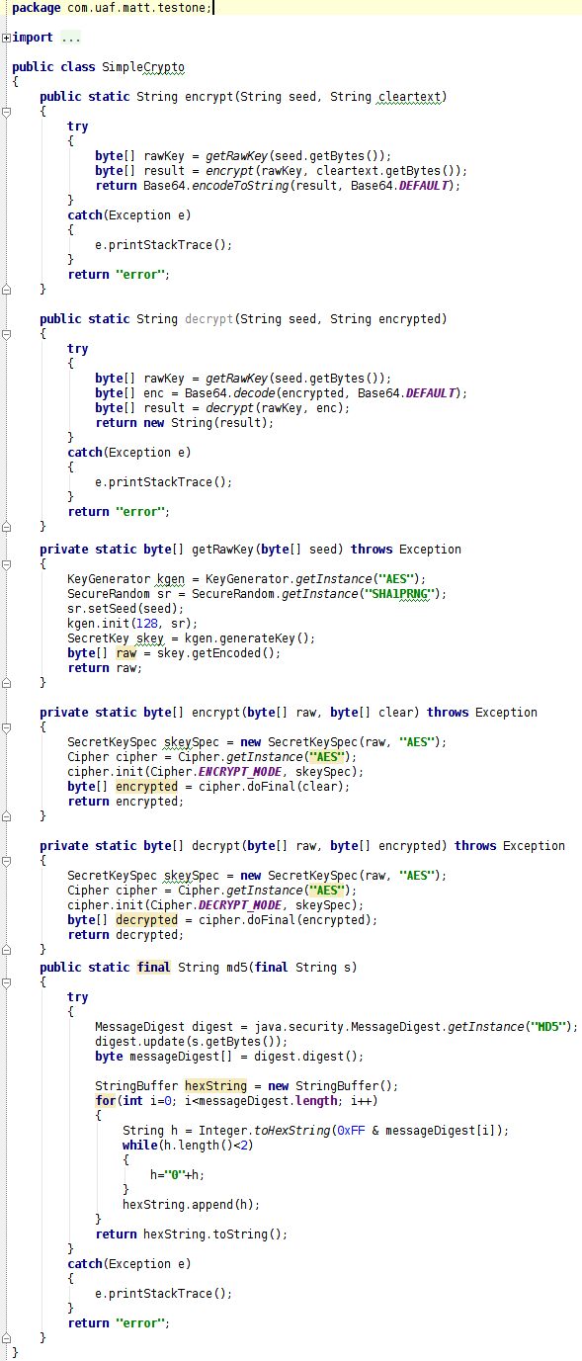
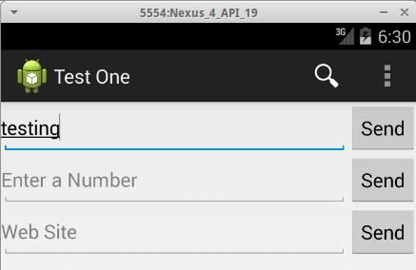
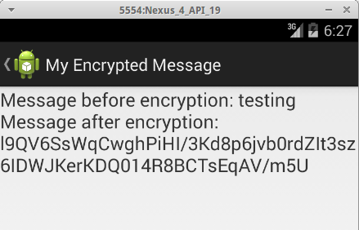
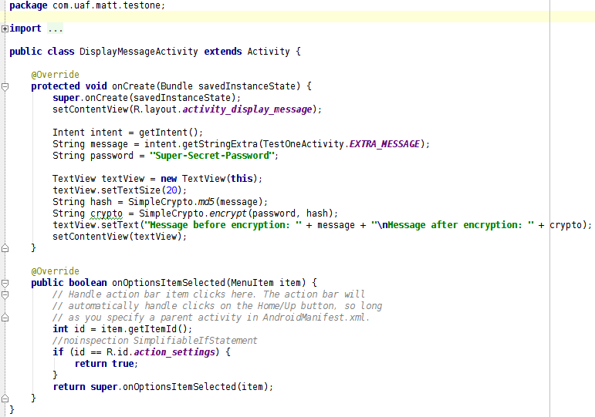
String Encryption Activity

Slide 10
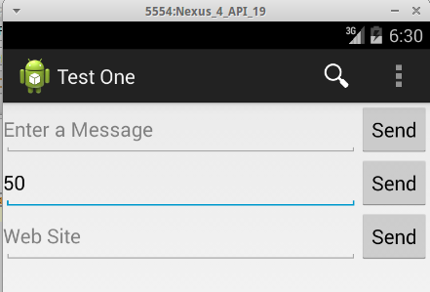
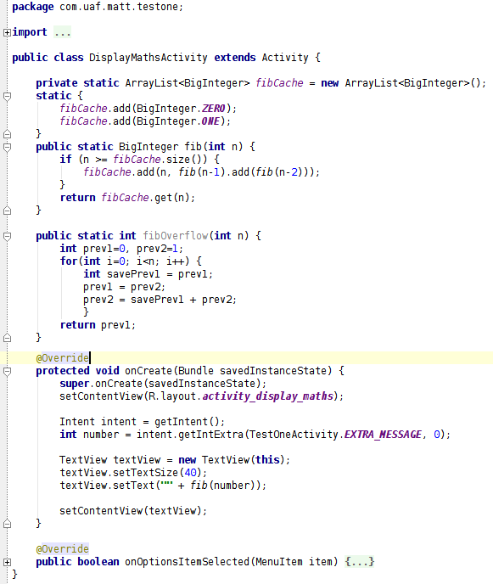
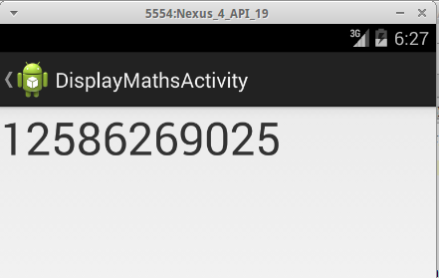
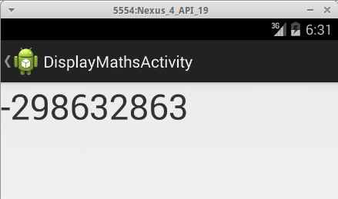
Fibonacci Calculator Activity
Without Overflow
With Overflow

Slide 11
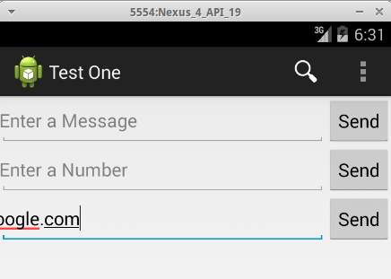
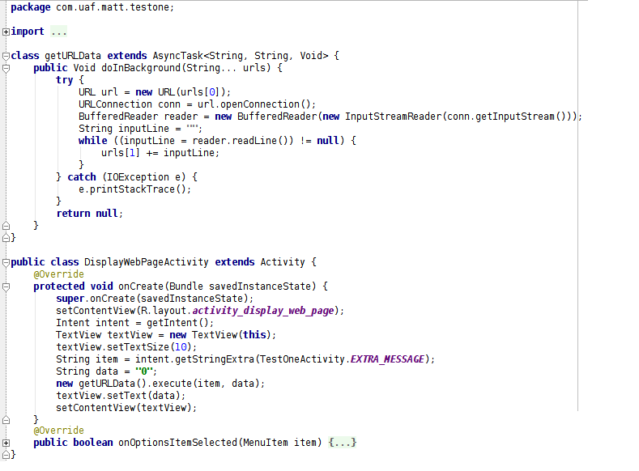
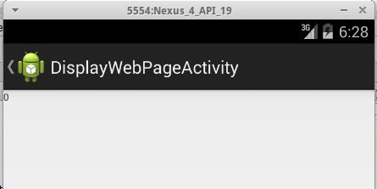
Webpage Activity

Slide 12
Obfuscation Programs
Proguard
JODE
jarg
JBCO
ClassEncrypt
KlassMaster
Allatori

Slide 13
Build/Obfuscation Process
Built with ant
In release mode
Digitally signed
Byte Aligned
dexdump
Static disassembly analysis of APKs
dex2jar/jar2dex
dex to jar translator and jar to dex translator

Slide 14
Build/Obfuscation Process - Proguard
Runs within ant
Strict obfuscation settings
Default Settings Plus:
-overloadaggressively
Multiple fields/methods can get the same name
-flattenpackagehierarchy
Repackage all packages into single parent package

Slide 15
Analysis of Proguard
Application Headers
Unobfuscated
Obfuscated
Processing 'classes.dex'...
Opened 'classes.dex', DEX version '035'
DEX file header:
magic : 'dex\n035\0'
checksum : 4afbaef1
signature : 9ec5...9586
file_size : 12172
header_size : 112
link_size : 0
link_off : 0 (0x000000)
string_ids_size : 245
string_ids_off : 112 (0x000070)
type_ids_size : 67
type_ids_off : 1092 (0x000444)
proto_ids_size : 55
proto_ids_off : 1360 (0x000550)
field_ids_size : 36
field_ids_off : 2020 (0x0007e4)
method_ids_size : 114
method_ids_off : 2308 (0x000904)
class_defs_size : 16
class_defs_off : 3220 (0x000c94)
data_size : 8440
data_off : 3732 (0x000e94)
Processing 'classes.dex'...
Opened 'classes.dex', DEX version '035'
DEX file header:
magic : 'dex\n035\0'
checksum : 1ab34520
signature : 780a...2df9
file_size : 6804
header_size : 112
link_size : 0
link_off : 0 (0x000000)
string_ids_size : 123
string_ids_off : 112 (0x000070)
type_ids_size : 51
type_ids_off : 604 (0x00025c)
proto_ids_size : 54
proto_ids_off : 808 (0x000328)
field_ids_size : 3
field_ids_off : 1456 (0x0005b0)
method_ids_size : 95
method_ids_off : 1480 (0x0005c8)
class_defs_size : 6
class_defs_off : 2240 (0x0008c0)
data_size : 4372
data_off : 2432 (0x000980)

Slide 16
Analysis of Proguard
No BuildConfig Class
Unobfuscated
Obfuscated
Class #0 header:
class_idx : 16
access_flags : 17 (0x0011)
superclass_idx : 46
interfaces_off : 0 (0x000000)
source_file_idx : 10
annotations_off : 0 (0x000000)
class_data_off : 11630 (0x002d6e)
static_fields_size : 1
instance_fields_size: 0
direct_methods_size : 1
virtual_methods_size: 0
Class #0 -
Class descriptor : 'Lcom/uaf/matt/
testone/BuildConfig;'
Access flags : 0x0011 (PUBLIC FINAL)
Superclass : 'Ljava/lang/Object;'
Interfaces -
Static fields -
.
.
.
Class #0 header:
class_idx : 15
access_flags : 1 (0x0001)
superclass_idx : 2
interfaces_off : 0 (0x000000)
source_file_idx : -1
annotations_off : 0 (0x000000)
class_data_off : 6515 (0x001973)
static_fields_size : 1
instance_fields_size: 0
direct_methods_size : 3
virtual_methods_size: 2
Class #0 -
Class descriptor : 'Lcom/uaf/matt/
testone/DisplayMathsActivity;'
Access flags : 0x0001 (PUBLIC)
Superclass : 'Landroid/app/Activity;'
Interfaces -
Static fields -
.
.
.

Slide 17
Analysis of Proguard
No Source File/Annotation
Variable Renamed
Unobfuscated
Obfuscated
Class #1 header:
class_idx : 17
access_flags : 1 (0x0001)
superclass_idx : 3
interfaces_off : 0 (0x000000)
source_file_idx : 13
annotations_off : 6296 (0x001898)
. . .
Class #1 -
Class descriptor : 'Lcom/uaf/matt/
testone/DisplayMathsActivity;'
Access flags : 0x0001 (PUBLIC)
Superclass : 'Landroid/app/Activity;'
Interfaces -
Static fields -
#0 : (in Lcom/uaf/matt/
testone/DisplayMathsActivity;)
name : 'fibCache'
type : 'Ljava/util/ArrayList;'
access : 0x000a (PRIVATE STATIC)
Instance fields -
Class #0 header:
class_idx : 15
access_flags : 1 (0x0001)
superclass_idx : 2
interfaces_off : 0 (0x000000)
source_file_idx : -1
annotations_off : 0 (0x000000)
. . .
Class #0 -
Class descriptor : 'Lcom/uaf/matt/
testone/DisplayMathsActivity;'
Access flags : 0x0001 (PUBLIC)
Superclass : 'Landroid/app/Activity;'
Interfaces -
Static fields -
#0 : (in Lcom/uaf/matt/
testone/DisplayMathsActivity;)
name : 'a'
type : 'Ljava/util/ArrayList;'
access : 0x000a (PRIVATE STATIC)
Instance fields -

Slide 18
Analysis of Proguard
No Debug Information
Unobfuscated
Obfuscated
. . .
catches : (none)
positions :
0x0000 line=47
0x0003 line=48
0x0008 line=50
0x000c line=51
0x0013 line=53
0x0018 line=54
0x001d line=55
0x0037 line=57
0x003a line=58
locals :
0x000c - 0x003b reg=0 intent Landroid/content/Intent;
0x0013 - 0x003b reg=1 number I
0x0018 - 0x003b reg=2 textView Landroid/widget/TextView;
0x0000 - 0x003b reg=5 this Lcom/uaf/matt/testone/DisplayMathsActivity;
0x0000 - 0x003b reg=6 savedInstanceState Landroid/os/Bundle;
. . .
. . .
catches : (none)
positions :
locals :
. . .

Slide 19
Build/Obfuscation Process - jarg
Does Not run within ant
dex2jar
converts classes.dex to jar
run jarg
strict as possible
-nobco
no bytecode obfuscation
jar2dex
converts the jar back to dex
repack into apk

Slide 20
Analysis of jarg
Application Headers
Unobfuscated
Obfuscated
Processing 'classes.dex'...
Opened 'classes.dex', DEX version '035'
DEX file header:
magic : 'dex\n035\0'
checksum : 4afbaef1
signature : 9ec5...9586
file_size : 12172
header_size : 112
link_size : 0
link_off : 0 (0x000000)
string_ids_size : 245
string_ids_off : 112 (0x000070)
type_ids_size : 67
type_ids_off : 1092 (0x000444)
proto_ids_size : 55
proto_ids_off : 1360 (0x000550)
field_ids_size : 36
field_ids_off : 2020 (0x0007e4)
method_ids_size : 114
method_ids_off : 2308 (0x000904)
class_defs_size : 16
class_defs_off : 3220 (0x000c94)
data_size : 8440
data_off : 3732 (0x000e94)
Processing 'classes-dex2jar_s-jar2dex.dex'...
Opened 'classes-dex2jar_s-jar2dex.dex', DEX version '035'
DEX file header:
magic : 'dex\n035\0'
checksum : 689961b6
signature : a55b...909d
file_size : 9444
header_size : 112
link_size : 0
link_off : 0 (0x000000)
string_ids_size : 169
string_ids_off : 112 (0x000070)
type_ids_size : 61
type_ids_off : 788 (0x000314)
proto_ids_size : 55
proto_ids_off : 1032 (0x000408)
field_ids_size : 36
field_ids_off : 1692 (0x00069c)
method_ids_size : 111
method_ids_off : 1980 (0x0007bc)
class_defs_size : 16
class_defs_off : 2868 (0x000b34)
data_size : 6064
data_off : 3380 (0x000d34)

Slide 21
Analysis of jarg
BuildConfig Class
Unobfuscated
Obfuscated
Class #0 header:
class_idx : 16
access_flags : 17 (0x0011)
superclass_idx : 46
interfaces_off : 0 (0x000000)
source_file_idx : 10
annotations_off : 0 (0x000000)
class_data_off : 11630 (0x002d6e)
static_fields_size : 1
instance_fields_size: 0
direct_methods_size : 1
virtual_methods_size: 0
Class #0 -
Class descriptor : 'Lcom/uaf/matt/
testone/BuildConfig;'
Access flags : 0x0011 (PUBLIC FINAL)
Superclass : 'Ljava/lang/Object;'
Interfaces -
Static fields -
Class #0 header:
class_idx : 15
access_flags : 17 (0x0011)
superclass_idx : 40
interfaces_off : 0 (0x000000)
source_file_idx : -1
annotations_off : 0 (0x000000)
class_data_off : 8961 (0x002301)
static_fields_size : 1
instance_fields_size: 0
direct_methods_size : 1
virtual_methods_size: 0
Class #0 -
Class descriptor : 'Lcom/uaf/matt/
testone/BuildConfig;'
Access flags : 0x0011 (PUBLIC FINAL)
Superclass : 'Ljava/lang/Object;'
Interfaces -
Static fields -

Slide 22
Analysis of jarg
No Source File/Annotations
Variable Renaming
Unobfuscated
Obfuscated
Class #1 header:
class_idx : 17
access_flags : 1 (0x0001)
superclass_idx : 3
interfaces_off : 0 (0x000000)
source_file_idx : 13
annotations_off : 6296 (0x001898)
. . .
Class #1 -
Class descriptor : 'Lcom/uaf/matt/
testone/DisplayMathsActivity;'
Access flags : 0x0001 (PUBLIC)
Superclass : 'Landroid/app/Activity;'
Interfaces -
Static fields -
#0 : (in Lcom/uaf/matt/
testone/DisplayMathsActivity;)
name : 'fibCache'
type : 'Ljava/util/ArrayList;'
access : 0x000a (PRIVATE STATIC)
Instance fields -
Class #1 header:
class_idx : 16
access_flags : 1 (0x0001)
superclass_idx : 2
interfaces_off : 0 (0x000000)
source_file_idx : -1
annotations_off : 0 (0x000000)
. . .
Class #1 -
Class descriptor : 'Lcom/uaf/matt/
testone/DisplayMathsActivity;'
Access flags : 0x0001 (PUBLIC)
Superclass : 'Landroid/app/Activity;'
Interfaces -
Static fields -
#0 : (in Lcom/uaf/matt/
testone/DisplayMathsActivity;)
name : 'a'
type : 'Ljava/util/ArrayList;'
access : 0x000a (PRIVATE STATIC)
Instance fields -

Slide 23
Analysis of jarg
BuildConfig Class
Unobfuscated
Obfuscated
catches : (none)
positions :
0x0000 line=47
0x0003 line=48
0x0008 line=50
0x000c line=51
0x0013 line=53
0x0018 line=54
0x001d line=55
0x0037 line=57
0x003a line=58
locals :
0x000c - 0x003b reg=0 intent Landroid/content/Intent;
0x0013 - 0x003b reg=1 number I
0x0018 - 0x003b reg=2 textView Landroid/widget/TextView;
0x0000 - 0x003b reg=5 this Lcom/uaf/matt/testone/DisplayMathsActivity;
0x0000 - 0x003b reg=6 savedInstanceState Landroid/os/Bundle;
catches : (none)
positions :
locals :

Slide 24
Build/Obfuscation Process - KlassMaster
Runs within ant
replaced the proguard.jar with ZKM.jar
runs with a “script file”
obfuscateFlow
exceptionObfuscation
encryptStringLiterals
mixedCaseClassNames
aggressiveMethodRenaming
autoReflectionHandling

Slide 25
Analysis of KlassMaster
Application Headers
Unobfuscated
Obfuscated
Processing 'classes.dex'...
Opened 'classes.dex', DEX version '035'
DEX file header:
magic : 'dex\n035\0'
checksum : 4afbaef1
signature : 9ec5...9586
file_size : 12172
header_size : 112
link_size : 0
link_off : 0 (0x000000)
string_ids_size : 245
string_ids_off : 112 (0x000070)
type_ids_size : 67
type_ids_off : 1092 (0x000444)
proto_ids_size : 55
proto_ids_off : 1360 (0x000550)
field_ids_size : 36
field_ids_off : 2020 (0x0007e4)
method_ids_size : 114
method_ids_off : 2308 (0x000904)
class_defs_size : 16
class_defs_off : 3220 (0x000c94)
data_size : 8440
data_off : 3732 (0x000e94)
Processing 'classes.dex'...
Opened 'classes.dex', DEX version '035'
DEX file header:
magic : 'dex\n035\0'
checksum : 52871191
signature : a35a...9a40
file_size : 9944
header_size : 112
link_size : 0
link_off : 0 (0x000000)
string_ids_size : 130
string_ids_off : 112 (0x000070)
type_ids_size : 52
type_ids_off : 632 (0x000278)
proto_ids_size : 56
proto_ids_off : 840 (0x000348)
field_ids_size : 10
field_ids_off : 1512 (0x0005e8)
method_ids_size : 102
method_ids_off : 1592 (0x000638)
class_defs_size : 6
class_defs_off : 2408 (0x000968)
data_size : 7344
data_off : 2600 (0x000a28)

Slide 26
Analysis of KlassMaster
No BuildConfig Class (I think)
Unobfuscated
Obfuscated
Class #0 header:
class_idx : 16
access_flags : 17 (0x0011)
superclass_idx : 46
interfaces_off : 0 (0x000000)
source_file_idx : 10
annotations_off : 0 (0x000000)
class_data_off : 11630 (0x002d6e)
static_fields_size : 1
instance_fields_size: 0
direct_methods_size : 1
virtual_methods_size: 0
Class #0 -
Class descriptor :
'Lcom/uaf/matt/testone/BuildConfig;'
Class #0 header:
class_idx : 2
access_flags : 0 (0x0000)
superclass_idx : 6
interfaces_off : 0 (0x000000)
source_file_idx : -1
annotations_off : 0 (0x000000)
class_data_off : 9619 (0x002593)
static_fields_size : 0
instance_fields_size: 0
direct_methods_size : 1
virtual_methods_size: 2
Class #0 -
Class descriptor : 'La;'

Slide 27
Analysis of KlassMaster
Class #1 header:
class_idx : 16
access_flags : 1 (0x0001)
superclass_idx : 3
interfaces_off : 0 (0x000000)
source_file_idx : -1
annotations_off : 0 (0x000000)
class_data_off : 9637 (0x0025a5)
static_fields_size : 2
instance_fields_size: 0
direct_methods_size : 2
virtual_methods_size: 2
Class #1 -
Class descriptor : 'Lb;'
Access flags : 0x0001 (PUBLIC)
Superclass : 'Landroid/app/Activity;'
Interfaces -
Static fields -
#0 : (in Lb;)
name : 'a'
type : 'I'
access : 0x0009 (PUBLIC STATIC)
#1 : (in Lb;)
name : 'z'
type : '[Ljava/lang/String;'
access : 0x001a (PRIVATE STATIC FINAL)
No Source File
No Annotations
Class Renamed
Variables Renamed
No Debug Info
catches : (none)
positions :
locals :

Slide 28
Analysis of KlassMaster
Control FLow Obfuscation
000c10: 0e00 |0070: return-void
000c12: 0176 |0071: move v6, v7
000c14: 28b0 |0072: goto 0022 // -0050
000c16: 1306 7d00 |0073: const/16 v6, #int 125 // #7d
000c1a: 28ad |0075: goto 0022 // -0053
000c1c: 0186 |0076: move v6, v8
000c1e: 28ab |0077: goto 0022 // -0055
000c20: 1306 6d00 |0078: const/16 v6, #int 109 // #6d
000c24: 28a8 |007a: goto 0022 // -0058
000c26: 0175 |007b: move v5, v7
000c28: 28d7 |007c: goto 0053 // -0029
000c2a: 1305 7d00 |007d: const/16 v5, #int 125 // #7d
000c2e: 28d4 |007f: goto 0053 // -002c
000c30: 0185 |0080: move v5, v8
000c32: 28d2 |0081: goto 0053 // -002e
000c34: 1305 6d00 |0082: const/16 v5, #int 109 // #6d
000c38: 28cf |0084: goto 0053 // -0031
000c3a: 0132 |0085: move v2, v3
000c3c: 28aa |0086: goto 0030 // -0056
000c3e: 0000 |0087: nop // spacer
000c40: 0001 0400 0000 0000 5300 0000 5500 ... |0088: packed-switch-data (12 units)
000c58: 0001 0400 0000 0000 2c00 0000 2e00 ... |0094: packed-switch-data (12 units)

Slide 29
Analysis of KlassMaster
String Encryption
000b3c: 121c |0006: const/4 v12, #int 1 // #1
000b3e: 1203 |0007: const/4 v3, #int 0 // #0
000b40: 1220 |0008: const/4 v0, #int 2 // #2
000b42: 230a 3300 |0009: new-array v10, v0, [Ljava/lang/String; // type@0033
000b46: 1a00 4c00 |000b: const-string v0, "[ D5RGx_h_`^RCnAXR~" // string@004c
000b4a: 6e10 4800 0000 |000d: invoke-virtual {v0}, Ljava/lang/String;.toCharArray:()[C // method@0048
000b50: 0c00 |0010: move-result-object v0
000b52: 2101 |0011: array-length v1, v0
000b54: 36c1 7300 |0012: if-gt v1, v12, 0085 // +0073

Slide 30
Build/Obfuscation Process - Allatori
Runs within ant
edited build script to point to allatori
allatori.xml
string encrypting
control flow obfuscation
package renaming
class/method/field renaming
line number obfuscation
member reordering
remove toString

Slide 31
Analysis of Allatori
Application Headers
Unobfuscated
Obfuscated
Processing 'classes.dex'...
Opened 'classes.dex', DEX version '035'
DEX file header:
magic : 'dex\n035\0'
checksum : 4afbaef1
signature : 9ec5...9586
file_size : 12172
header_size : 112
link_size : 0
link_off : 0 (0x000000)
string_ids_size : 245
string_ids_off : 112 (0x000070)
type_ids_size : 67
type_ids_off : 1092 (0x000444)
proto_ids_size : 55
proto_ids_off : 1360 (0x000550)
field_ids_size : 36
field_ids_off : 2020 (0x0007e4)
method_ids_size : 114
method_ids_off : 2308 (0x000904)
class_defs_size : 16
class_defs_off : 3220 (0x000c94)
data_size : 8440
data_off : 3732 (0x000e94)
Processing 'classes.dex'...
Opened 'classes.dex', DEX version '035'
DEX file header:
magic : 'dex\n035\0'
checksum : 6706eb4a
signature : c695...7930
file_size : 10900
header_size : 112
link_size : 0
link_off : 0 (0x000000)
string_ids_size : 172
string_ids_off : 112 (0x000070)
type_ids_size : 69
type_ids_off : 800 (0x000320)
proto_ids_size : 59
proto_ids_off : 1076 (0x000434)
field_ids_size : 36
field_ids_off : 1784 (0x0006f8)
method_ids_size : 124
method_ids_off : 2072 (0x000818)
class_defs_size : 16
class_defs_off : 3064 (0x000bf8)
data_size : 7324
data_off : 3576 (0x000df8)

Slide 32
Analysis of Allatori
BuildConfig Class but renamed (I think)
Unobfuscated
Obfuscated
Class #0 header:
class_idx : 16
access_flags : 17 (0x0011)
superclass_idx : 46
interfaces_off : 0 (0x000000)
source_file_idx : 10
annotations_off : 0 (0x000000)
class_data_off : 11630 (0x002d6e)
static_fields_size : 1
instance_fields_size: 0
direct_methods_size : 1
virtual_methods_size: 0
Class #0 -
Class descriptor :
'Lcom/uaf/matt/testone/BuildConfig;'
Class #0 header:
class_idx : 16
access_flags : 17 (0x0011)
superclass_idx : 45
interfaces_off : 0 (0x000000)
source_file_idx : 140
annotations_off : 6548 (0x001994)
class_data_off : 10292 (0x002834)
static_fields_size : 11
instance_fields_size: 0
direct_methods_size : 1
virtual_methods_size: 0
Class #0 -
Class descriptor : 'Lcom/package/E;'

Slide 33
Analysis of Allatori
Class #1 header:
class_idx : 17
access_flags : 17 (0x0011)
superclass_idx : 45
interfaces_off : 0 (0x000000)
source_file_idx : 140
annotations_off : 6548 (0x001994)
. . .
Class #1 -
Class descriptor : 'Lcom/package/G;'
Access flags : 0x0011 (PUBLIC FINAL)
Superclass : 'Ljava/lang/Object;'
Interfaces -
Static fields -
#0 : (in Lcom/package/G;)
name : 'ALLATORIxDEMO'
type : 'I'
access : 0x1019 (PUBLIC STATIC FINAL SYNTHETIC)
#1 : (in Lcom/package/G;)
name : 'H'
type : 'I'
access : 0x1019 (PUBLIC STATIC FINAL SYNTHETIC)
#2 : (in Lcom/package/G;)
name : 'K'
type : 'I'
access : 0x1019 (PUBLIC STATIC FINAL SYNTHETIC)
Source File IDX obfuscated
Annotations Offset Obfuscated
Class Renamed
Variables Renamed
Access Type changed to ___ ____ ____ SYNTHETIC

Slide 34
Analysis of Allatori
String Encryption
000f8a: 1a01 0a00 |0001: const-string v1, "Bq" // string@000a
000f8e: 7110 2000 0100 |0003: invoke-static {v1}, Lcom/package/e;.d:(Ljava/lang/String;)Ljava/lang/String;
// method@0020
000f94: 0c01 |0006: move-result-object v1
000f96: 7110 6b00 0100 |0007: invoke-static {v1}, Ljava/security/MessageDigest;.getInstance:(Ljava/lang/String;)Ljava/security/MessageDigest; // method@006b

Slide 35
Analysis of Allatori
Line Number obfuscation
locals removed
Unobfuscated
Obfuscated
catches : 1
0x0000 - 0x0038
Ljava/io/IOException; -> 0x0039
positions :
0x0000 line=19
0x0008 line=20
0x000c line=21
0x001a line=22
0x001c line=23
0x0022 line=24
0x0039 line=26
0x003a line=27
0x003d line=29
locals :
0x000c - 0x0039 reg=0 conn Ljava/net/URLConnection;
0x001c - 0x0039 reg=2 inputLine Ljava/lang/String;
0x001a - 0x0039 reg=3 reader Ljava/io/BufferedReader;
0x0008 - 0x0039 reg=4 url Ljava/net/URL;
0x003a - 0x003d reg=1 e Ljava/io/IOException;
0x0000 - 0x003f reg=8 this Lcom/uaf/matt/testone/getURLData;
0x0000 - 0x003f reg=9 urls [Ljava/lang/String;
catches : 1
0x0000 - 0x0038
Ljava/io/IOException; -> 0x0039
positions :
0x0000 line=182
0x0008 line=92
0x000c line=42
0x001a line=188
0x001c line=70
0x0022 line=44
0x0039 line=28
0x003a line=104
0x003d line=122
locals :
0x0000 - 0x003f reg=5 this Lcom/package/M;
0x0000 - 0x003f reg=6 arg0 [Ljava/lang/String;

Slide 36
Obfuscation Summary
Proguard
jarg
No BuildConfig Class
source_file_idx = -1
annotations_off = 0
no positions/locals defined
Variable Renaming
BuildConfig Class Present
source_file_idx = -1
annotations_off = 0
no positions/locals defined
Variable Renaming
KlassMaster
Allatori
No BuildConfig Class
source_file_idx = -1
annotations_off = 0
Variable/Class Renaming
String Encryption
BuildConfig Class Present
source_file_idx obfuscated
annotations_off obfuscated
Variable/Class Renaming
String Encryption
line number obfuscated

Slide 37
Looking into the Future
February - March
Give 2nd Presentation
Look closer at ByteCode
Write program to Fingerprint
Use IDA Pro (for cfg)
(stretch) Multiple obfuscators run on same program
April
4/7 Give Final Talk
Run program against commercial Apps
Finish Writeup

Slide 38
Questions?

